Slide 1
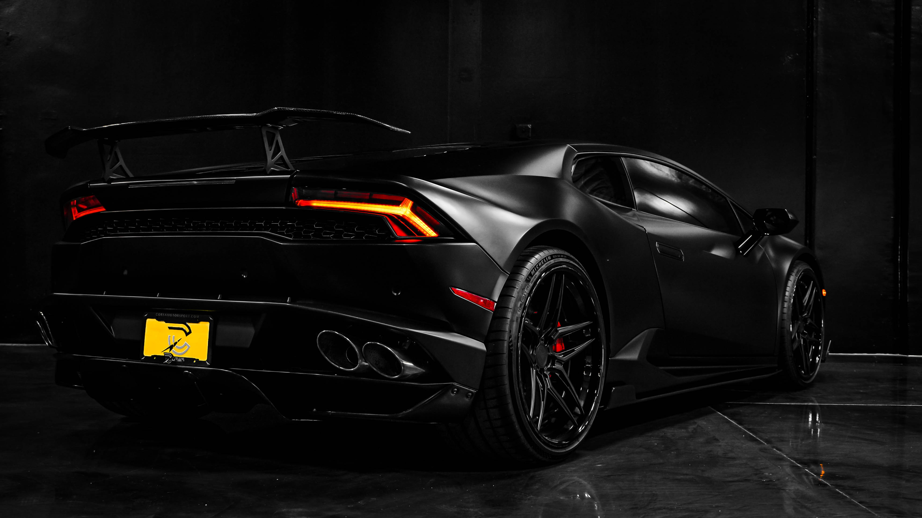

PREDICTING USED CAR PRICES
Presented by
UTKARSH RAJ

Slide 2
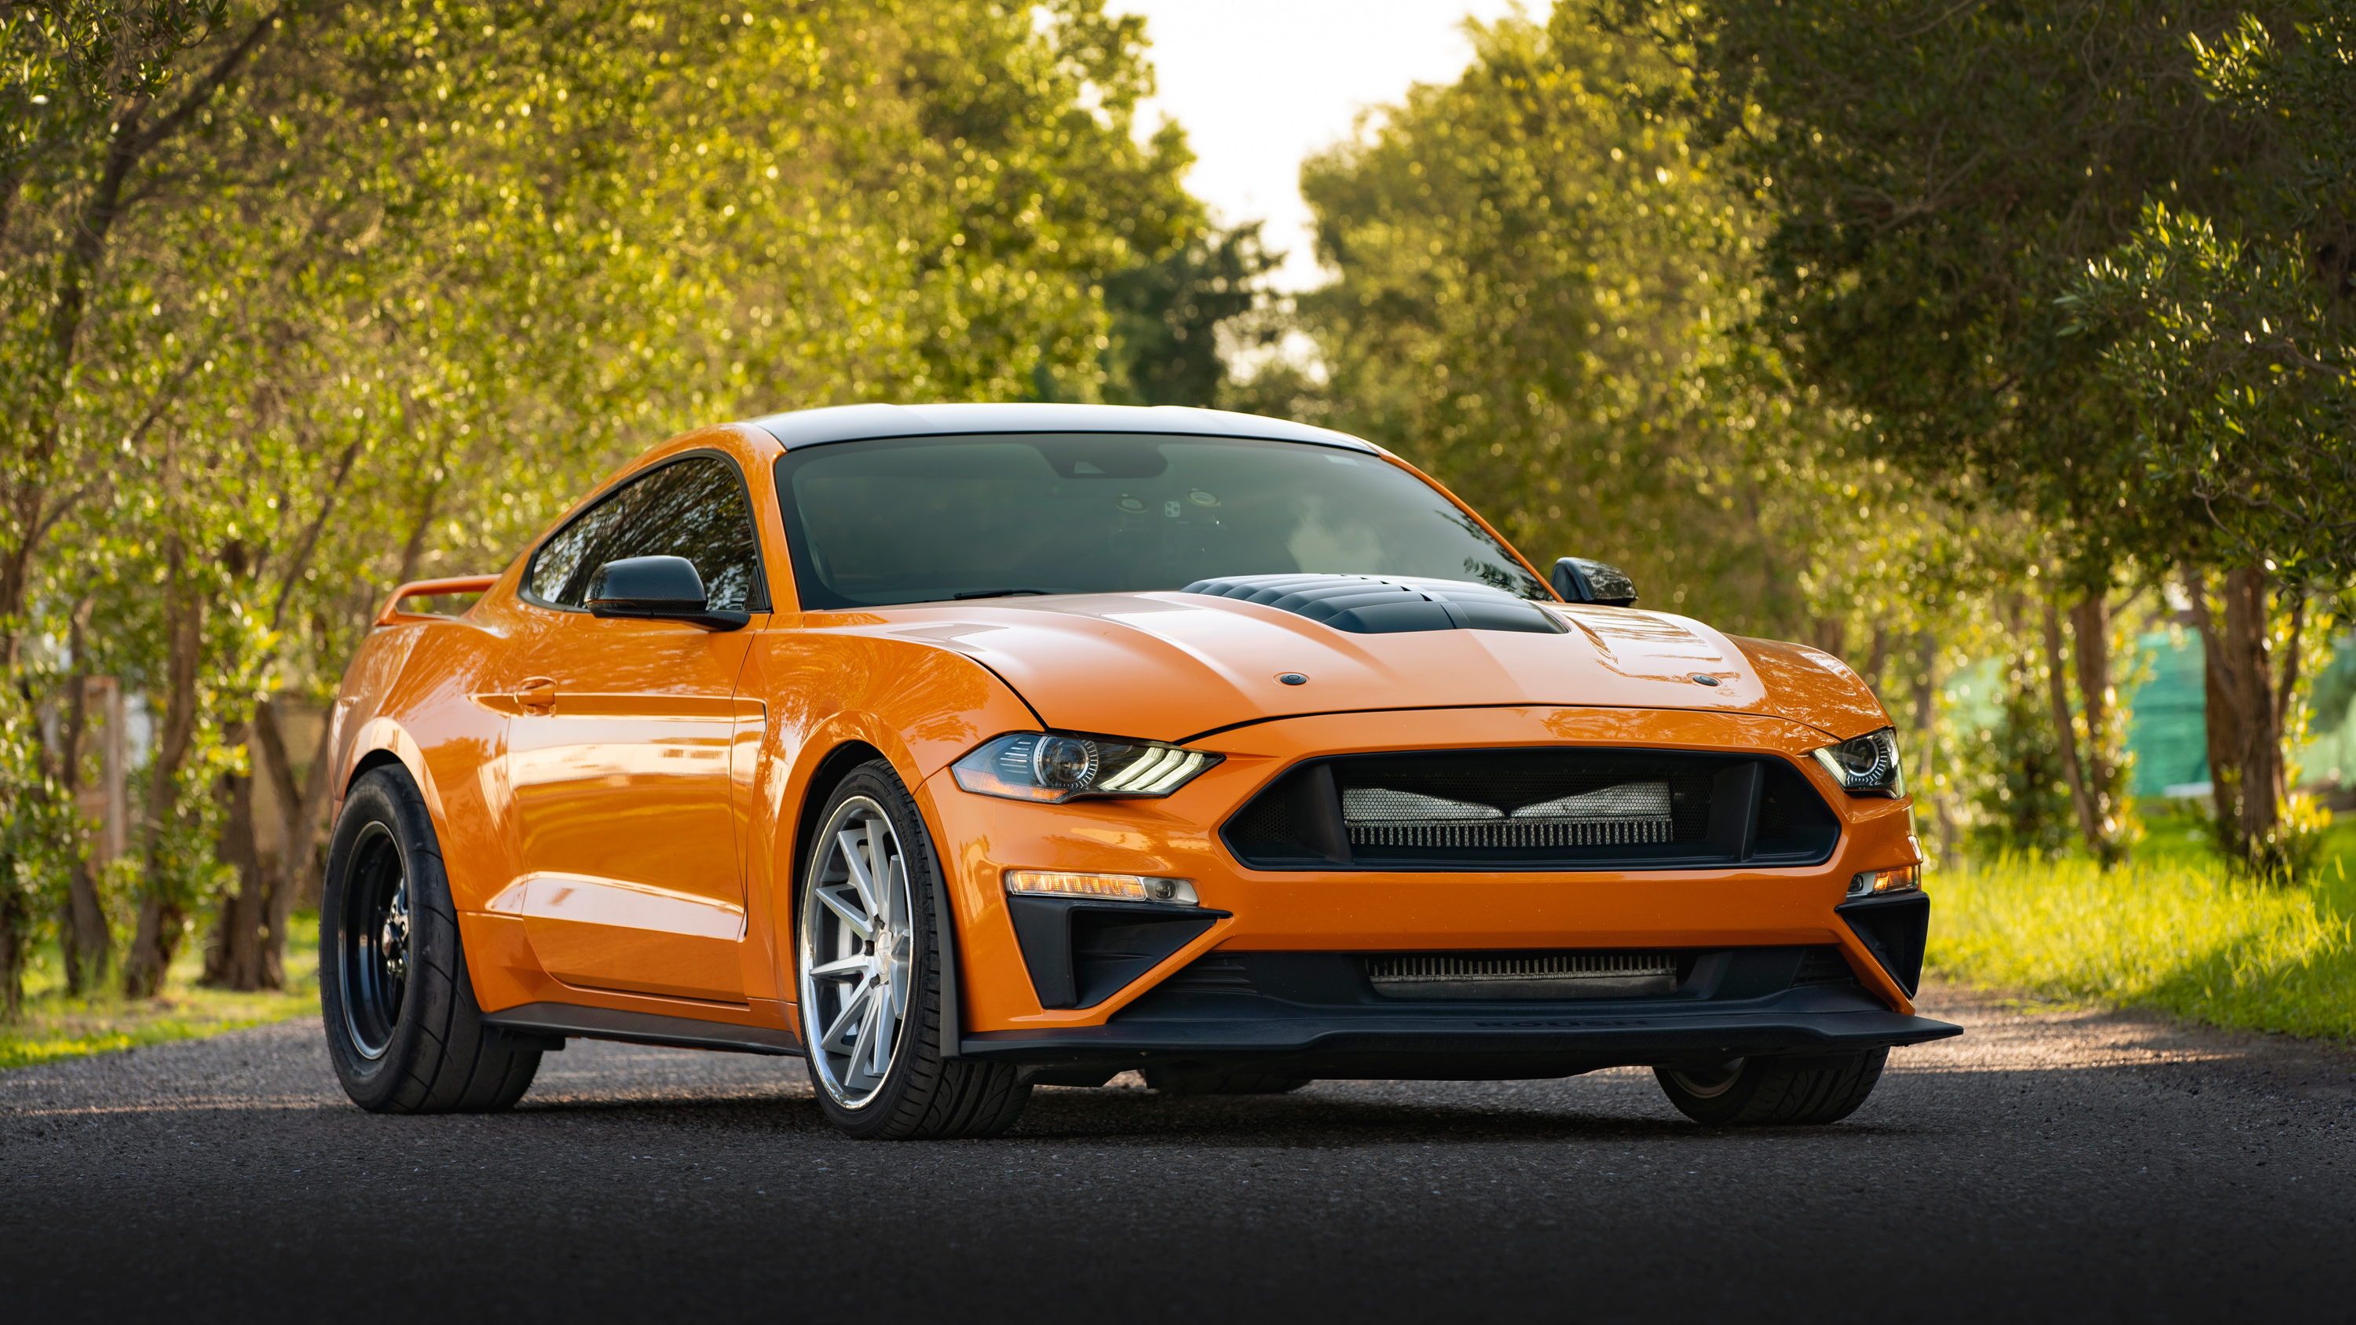

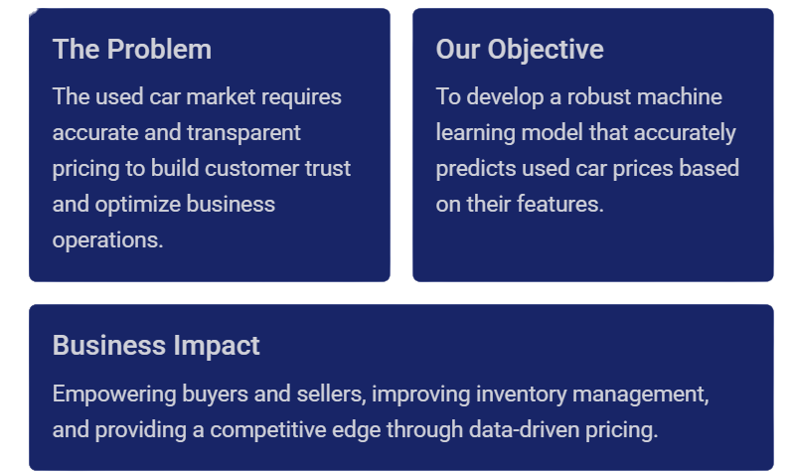
Introduction

Slide 3
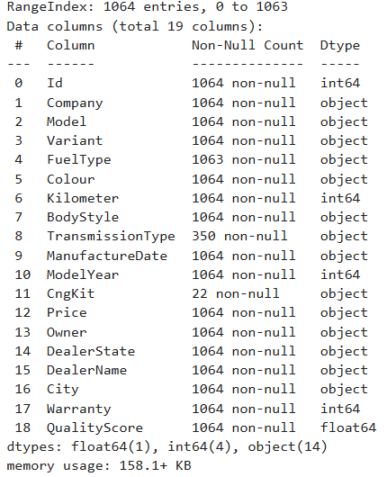


DATASET OVERVIEW
Data Source & Structure
Source: usedCars.csv
Size: 1,064 records with 19 initial features
Data Types: A comprehensive mix of numerical and categorical data
Key Initial Observations
Price column stored as text object requiring conversion
Significant missing data in TransmissionType and CngKit columns
Rich feature set covering vehicle specifications and market data

Slide 4
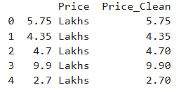
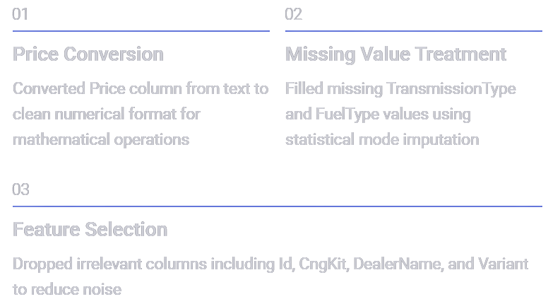
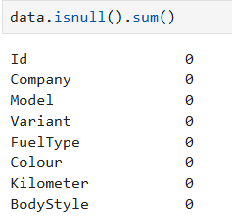
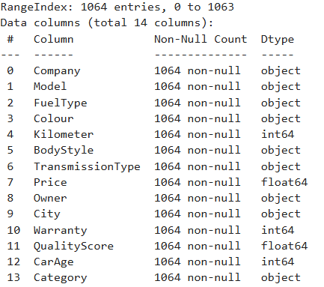
DATA CLEANING PROCESS
Our objective was to create a reliable, clean dataset that would serve as a solid foundation for accurate machine learning modeling.

Slide 5
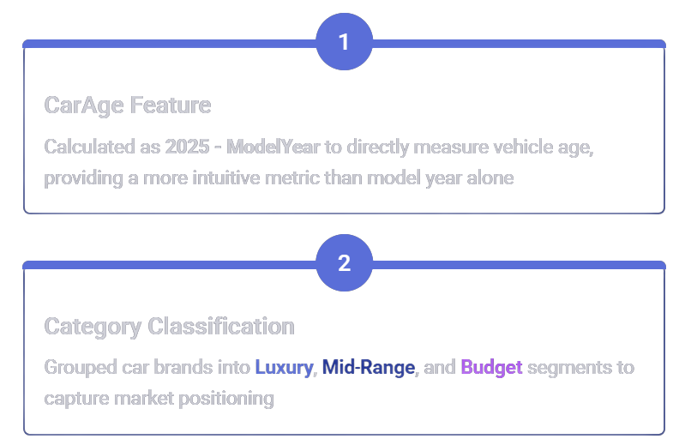
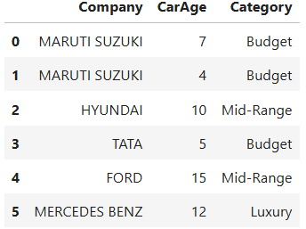
FEATURE ENGINEERING
These engineered features were designed to create more powerful and intuitive inputs that better capture the underlying factors affecting car prices in the marketplace.

Slide 6
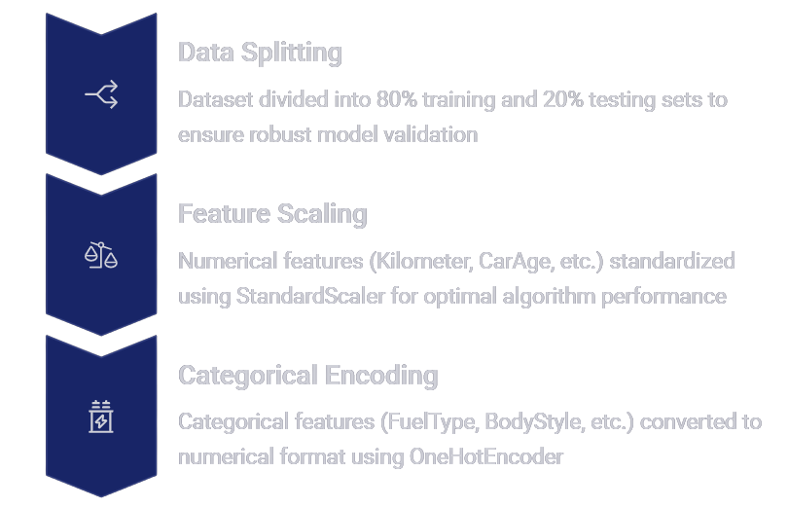
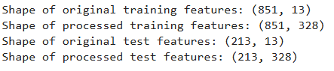
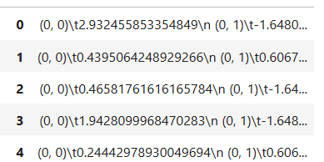
DATA PREPROCESSING PIPELINE
These engineered features were designed to create more powerful and intuitive inputs that better capture the underlying factors affecting car prices in the marketplace.

Slide 7
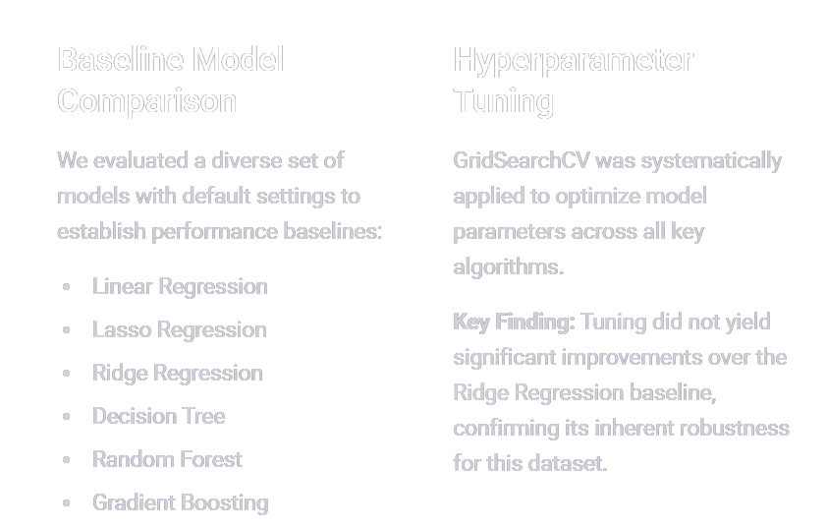
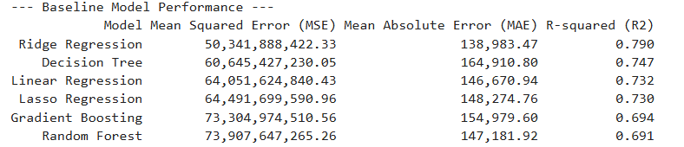
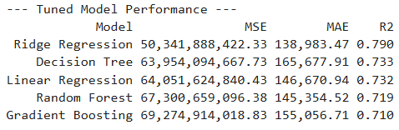
MODEL PERFORMANCE ANALYSIS
Top Performer: Ridge Regression achieved an impressive R-squared of 0.790

Slide 8
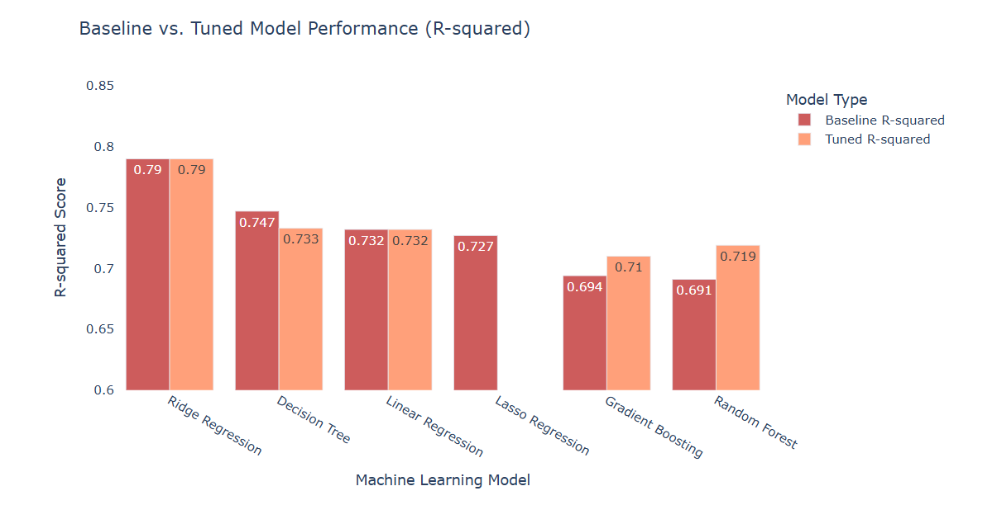
FINAL MODEL COMPARISON
The comparison clearly demonstrates Ridge Regression's superior performance, maintaining consistent accuracy across both baseline and tuned configurations while delivering the lowest prediction errors.

Slide 9
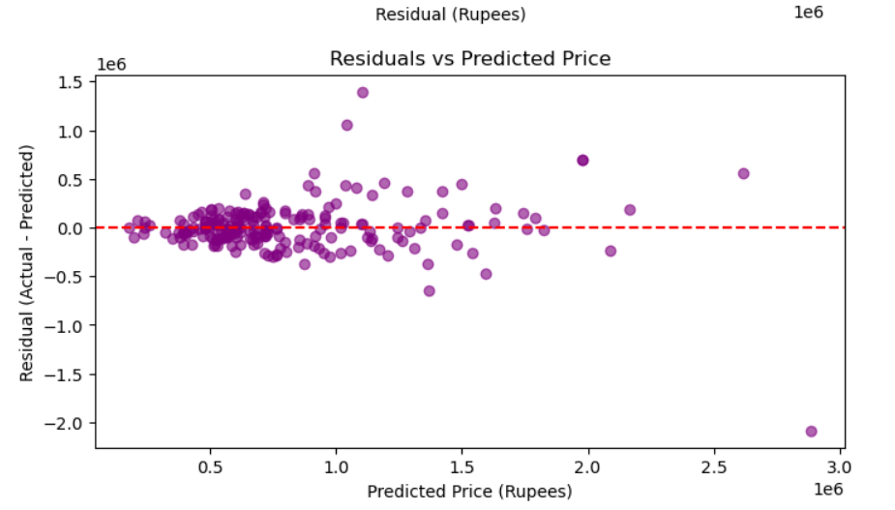


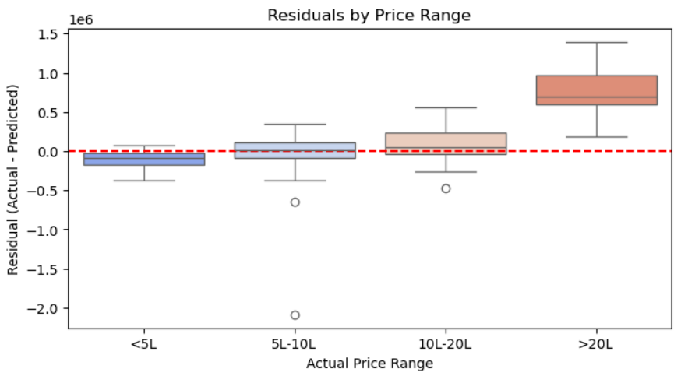

FINAL MODEL SELECTION: RIDGE REGRESSION
Highest Accuracy
Achieved the best R-squared score of 0.790 and lowest Mean Absolute Error of ₹138,983
Robust & Stable
Performed exceptionally well out-of-the-box, indicating strong resistance to overfitting on this dataset.

Slide 10
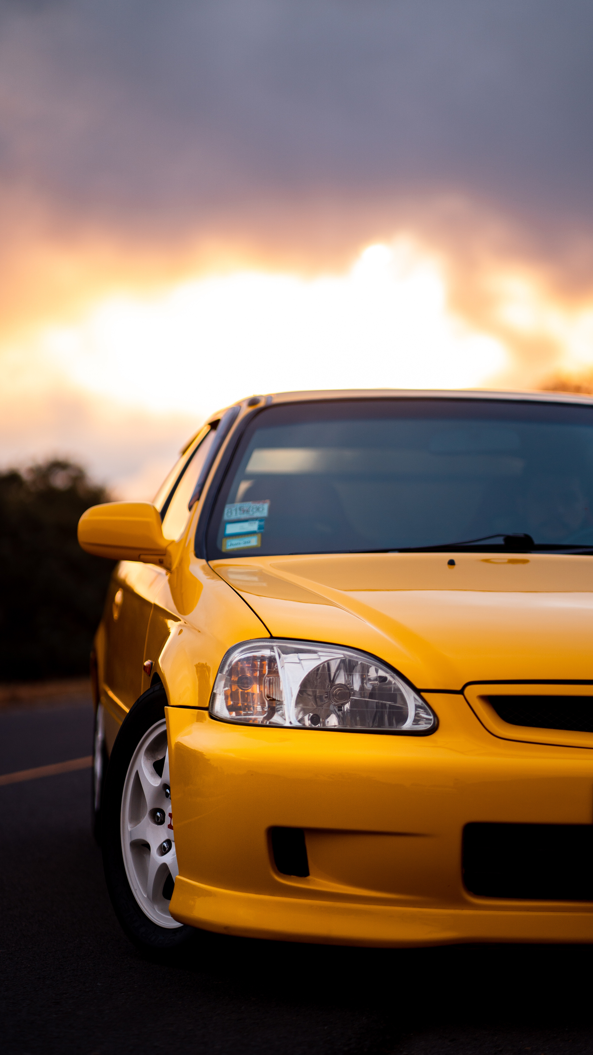
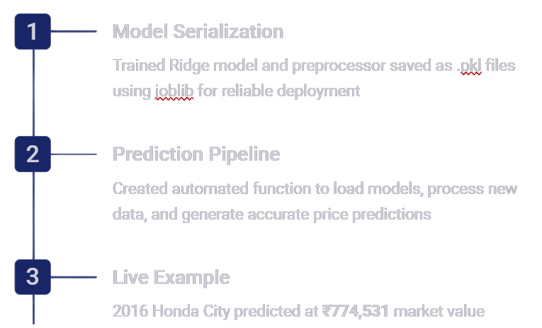
MODEL DEPLOYMENT & LIVE PREDICTION

Slide 11
CONCLUSION
Outcome: Delivered a production-ready ML model with strong business value.
Next Steps: Expand dataset, integrate with business systems, monitor ongoing model health.
Acknowledgments: Data sources, scikit-learn, pandas, project contributors.

Slide 12
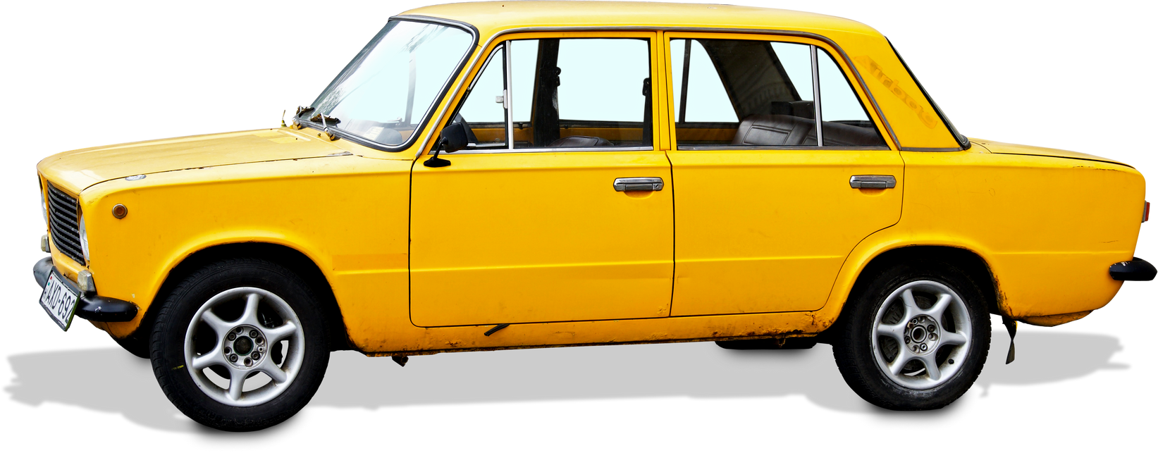
THANK YOU

